Slide 1

Sells of Video game analyses by Shahad Ghawa

Slide 2
Introduction
- The fact of Spread of video game it's not hiding from everyone now, the Competition between the publisher that responsible of improve the gams is so increase also they have to satisfaction the audience in different platform .

Slide 3
objective
in this data sit I tried to find the line of increase the total sells between multiple country's throwing years .
understand what is real factor that effect directly in this increase .

Slide 4
Understanding and analysis data
Data :
The number of data point is 16598 and 11 fetcher.
Data processing :
1- Extract the dataset.
2- Clean the data.
3- Removing duplicate or unnecessary data.
4- Fixing inconsistencies and typos.
5- Dealing with outliers and missing data.

Slide 5
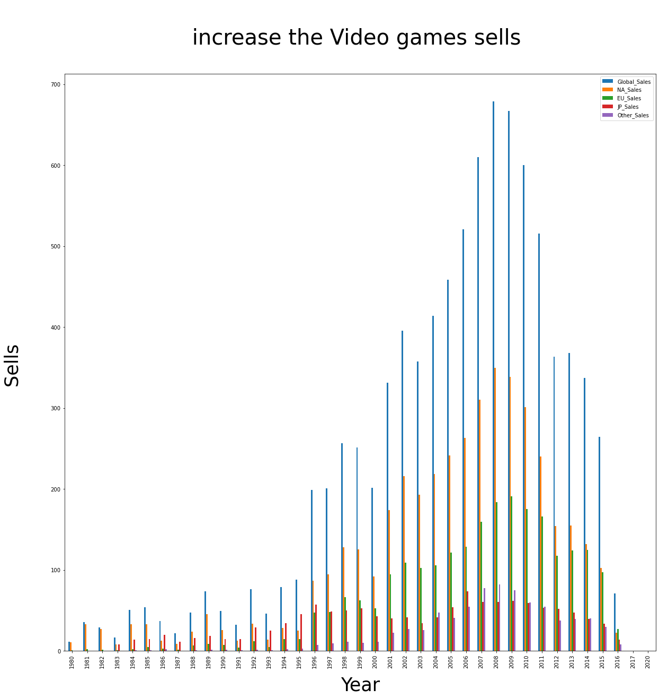
1-what is the different between country sells ?

Slide 6
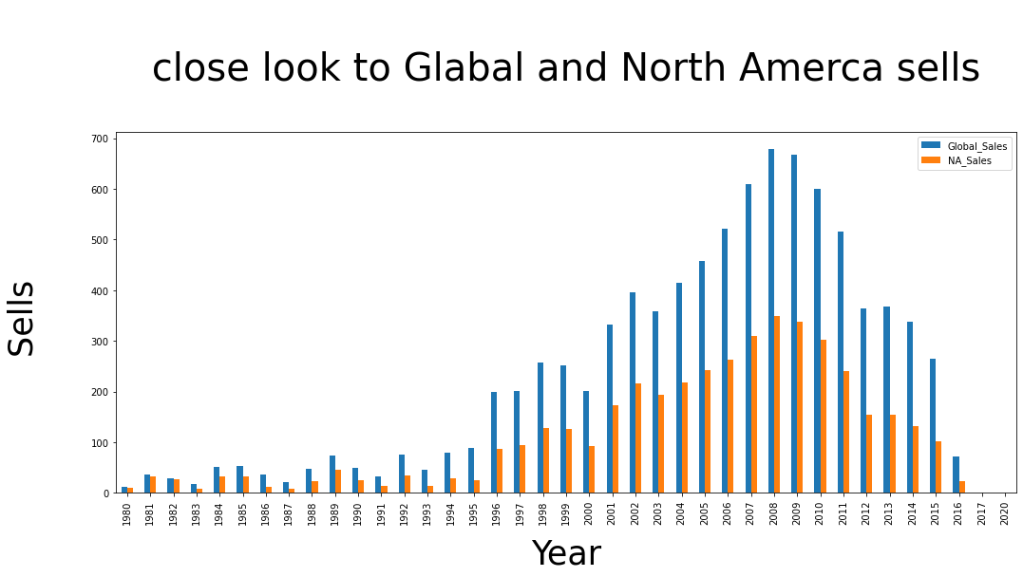
2- what is the highest years the sells is increase between Global & North America?

Slide 7
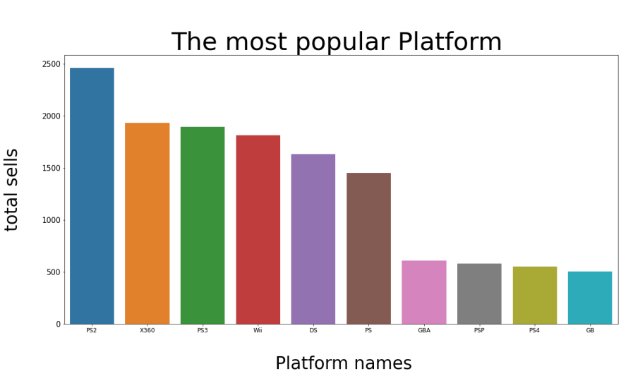
3- which was popular platform and Publisher according to the sells value?
Play station 2

Slide 8
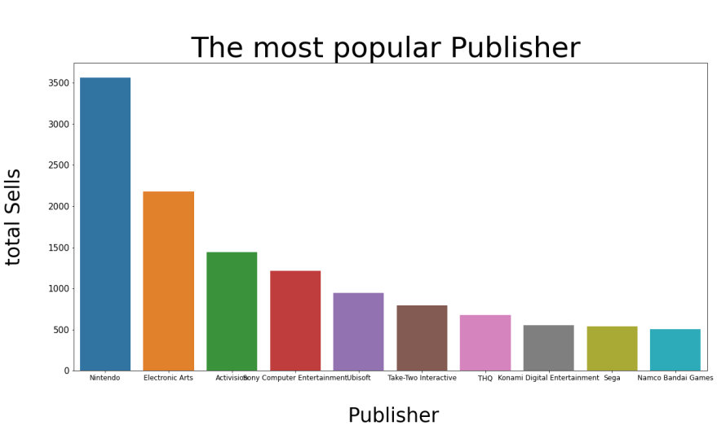
Nintendo

Slide 9
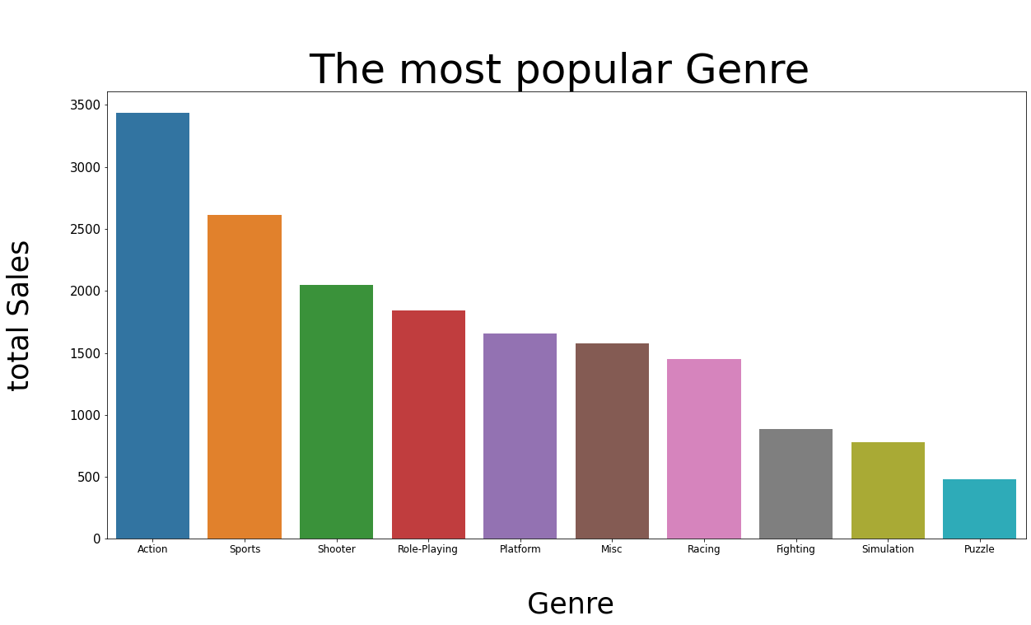
The most popular genre
Action

Slide 10
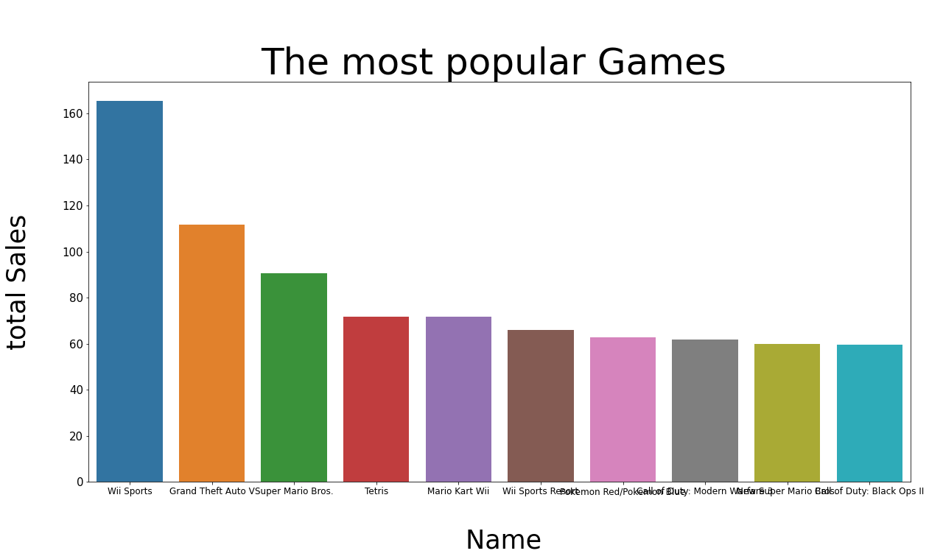
The most popular video games
Wii sport

Slide 11
Model result :
I have used of three models to get the best results :
Linear Reression 0.08963151080162801
Decision Tree Regressor
0,8428215658608792
Random Forest Regression
0,8245228538243715

Slide 12
Conclusions
The computation in the bagging include view country's and tern out to be global level .
The model may will the video games company's to improve the games according to multiple factors to rich as possible gamer they can .
The decrease in sells in view last years in general changing when the audience torn in anther platform .

